Slide 1
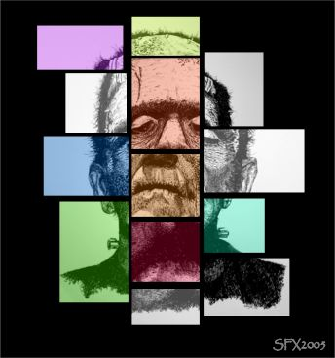
Frankenstein
Modern Prometheus
Pick up an “Anticipating Themes” Worksheet and respond to each statement.
*DID EVERYONE EMAIL ME THEIR ROTAM REFLECTIVE ESSAY???* If you forgot, please email it to me by 5PM tonight since it was technically 2 minutes ago. You are given this lag time because I forgot to write on the blog: “EMAIL papers: no hard copies necessary.”

Slide 2
Mary Shelley
Born in 1797 to William Godwin and Mary Wollstonecraft
Her mother died shortly after Mary was born
Shelley learned about her mother only through writings her mother left behind, including A Vindication of the Rights of Women (1792) which advocated that women should have the same educational opportunities as rights in society as men.

Slide 3
Mary Shelley
Avid reader and scholar and knew through her father some of the most important men of the time (William Wordsworth and Samuel Taylor Coleridge)
Married (scandal!) Percy Bysshe Shelley in 1816 and listened intently to his intellectual conversations with others

Slide 4
Mary Shelley
On a visit in Switzerland with PBS to Lord Byron, she was challenged to write a story. She had heard Byron and Shelley discussing “the nature of the principle of life and whether there was any chance of its ever being discovered.” From this conversation, she had the “waking dream” which eventually became the novel Frankenstein.

Slide 5
Historical Context
Ambiguous Walton’s letters dated “17-” with no reference to anything specific to pinpoint the date.
It is set in the latter part of the 18th century, at the end of the Enlightenment and the beginning of the Romantic period.
It critiques the excesses of the Enlightenment and introduces the beliefs of the Romantics.
Reflects a shift in social and political thought – from humans as creatures who use science and reason to shape and control their destiny to humans as creatures who rely on their emotions to determine what is right.

Slide 6
Ideas of the Enlightenment
Scientific observation of the outer world
Logic and reason; science and technology
Believed in following standards and traditions
Appreciated elegance and refinement
Interested in maintaining the aristocracy
Sought to follow and validate authority
Favored a social hierarchy
Nature should be controlled by humans

Slide 7
Important Revolutions
American and French Revolution (call for individual freedom and an overthrow of rigid social hierarchy)
Industrial Revolution – social system challenged by change from agricultural society to industrial one with a large, impoverished and restless working class

Slide 8
Characteristics of Romantic Period
Emphasis on imagination and emotion, individual passion and inspiration
Rejection of formal, upper class works and a preference for writing (poetry) that addresses personal experiences and emotions in simple, language
A turn to the past or an inner dream world that is thought to be more picturesque and magical than the current world (industrial age)

Slide 9
Characteristics of Romantic Period
Belief in individual liberty; rebellious attitude against tyranny
Fascination with nature; perception of nature as transformative

Slide 10
Characteristics of Romantic Period
Concerned with common people
Favored democracy
Desired radical change
Nature should be untamed

Slide 11
Style: Gothic Novel
Frankenstein is generally categorized as a Gothic novel, a genre of fiction that uses gloomy settings and supernatural events to create and atmosphere of mystery and terror.
Shelley adds to her development of the plot the use of psychological realism, delving into the psyches of the characters in and attempt to explain why they react as they do and what drives them to make their decisions.

Slide 12
Structure and Point of View
Robert Walton’s letters
Frankenstein's story to Walton
Creature's story
to Frankenstein
Frame Story
Epistolary – carried by letters

Slide 13
What is a frame story?
How is the story told?
Outer frame is formed by letters and (toward the end) notes of Captain Walton, writing to his sister.
The major inner frame (pp. 14-155) consists of Frankenstein’s narrative to Captain Walton.
Pages 70-104 frame the most inward space of the inner frame, the tale told by the Monster to Victor Frankenstein, and reported to Walton.

Slide 14
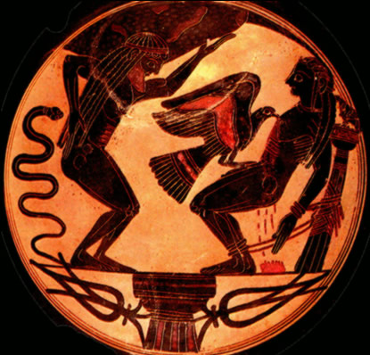
The Modern Prometheus
Prometheus, a figure from Greek
mythology.
A Titan who stole fire from the Gods and
gave it to humanity, initiating all the arts of
human civilization but angering the Gods,
especially Zeus.
In various versions of the myth, Prometheus was also held to have been the creator of humankind, molding human beings from clay, and guarding humanity against the angry Gods.
For his actions, however they are construed, Prometheus was severely punished by Zeus. The most influential account from classical antiquity, Zeus chained Prometheus to Mount Caucasus and set upon him an eagle (in other versions a vulture) who each day ate away at his liver which would be regenerated by night.
Mary Shelley's novel unifies all strands of the myth in a complex, multifaceted form.
Notes:
Try to get students to interpret the myth symbolically. What might the “fire” represent?
Why was Zeus angry? What might have prompted Prometheus to do what he did? Who is Prometheus? Is he the defender against man kind, fighting even against god
Look at Chapter 2&3 – what are victor’s motivations? Why do you think MS subtitled her book the Modern Prometheus?

Slide 15
Major Characters
Victor Frankenstein
The Creature
Henry Clerval
Elizabeth
Robert Walton
Notes:
Henry Clerval – Victor’s childhood friend; true romantic, wants to leave mark on the world, but never loses sight of “the moral relations of things:
Elizabeth – adopted as an infant by Victor’s family; marries Victor
Robert Walton – Arctic explorer who’s obsessed with gaining knowledge and fame; rescues Victor in the Arctic; tells the story
The Creature - never named; is Victor’s doppelganger (alter ego); Creature rationally analyzes the society that rejects him; sympathetic character, admires people and wants to be a part of human society; only results in violence when he is repeatedly rejected
Victor Frankenstein – protagonist, product of an idealistic Enlightenment education; fueled by possibilities of science and a desire for acclaim; becomes obsessed with creating life from spare body parts. Rational demeanor dissolves and by story’s end, consumed by primitive emotions of fear and hatred.

Slide 16
The creation of the monster…
Let’s look back at Chapter 5.
Pay close attention to the words Victor uses to describe his creation.
What is his reaction?

Slide 17
The Creature
Quickly go through the text and write down all of the words that are used to describe the creature (good pages to begin: 35, 36, 50, 51, 52 – I’m sure there are more!)
Think about characterization of the monster: who is describing him in that way and why? Does it affect our perspective?
Notes:
Show youtube clips

Slide 18
Chs. 8 & 9: Poor Justine!
What happened to Justine?
Why did Victor let her take the fall?
Do you think he was justified?

Slide 19
Subjects
Consequences of irresponsibility in the pursuit of knowledge
Consequences of pride
Consequences of society’s rejection of someone who is unattractive
Destructive power of revenge
Parent-child conflicts
Sympathy

Slide 20
Antithesis-Contrasts of ideas, characters, themes, settings or moods
Masculine/feminine
Beautiful/ugly
Good/bad
Light/dark
Heat/cold
Victor/creation
Passion/reason
Natural/unnatural
Known/unknown
Civilized/savage

Slide 21
Allusion
Paradise Lost by John Milton – story of man’s fall from innocence to painful knowledge; Victor can be compared to Adam, Satan, and Eve
The Rime of the Ancient Mariner by Samuel Taylor Coleridge, like narrator, tells story as a warning and a confession

Slide 22
Homework
Poetry Response #3
Read pages 71-104 (chapters 11-16)

